Slide 1

Career in Civil Engineering for First Year Engineering Students
  Pravin Kolhe,
  Executive Engineer,
  Maharashtra Water Resources Department
  www.pravinkolhe.com

Slide 2

Welcome to Engineering

Slide 3
Science, Engineering & Technology
Understanding Natural Rules
Science
Technology
Engineering
Outcome of Engineering Design
Application of Science to make life safe & conforable

Slide 4

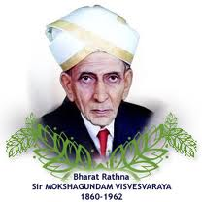



Engineering Profession
Engineer earns from Prosperity
Birth Anniversary of Sir Mokshagundam Visvesvarayya is celebrated as Engineers day.
He was a Civil Engineer

Slide 5
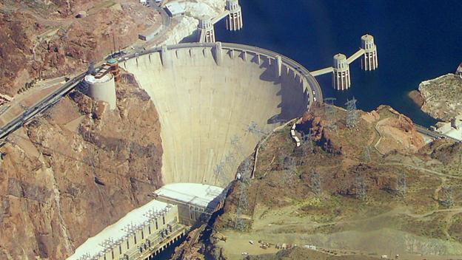
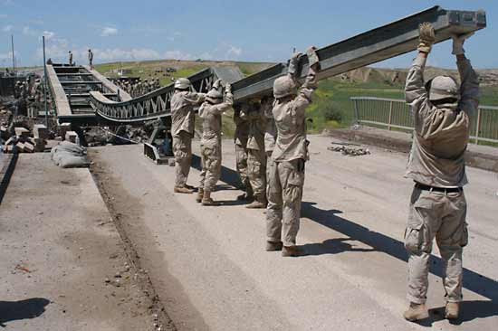
Basic Branches of Engineering
Basic Branches of Engineering
  Military
  Civil

Slide 6
What is Engineering?
Engineering is application of science for safeguarding life & property.
  Safety
  Economy
  Serviceability
  Aesthetic

Slide 7

Why to become a Civil Engineer?
Parents wants?
I don’t know…
For money? For comfort?
For satisfaction
To achieve ‘something’ in life

Slide 8

What is Civil Engineering?
Civil Engineering is broad field of engineering, which deals with the planning, construction and maintenance of structures or public works as they are related earth, water or in space.

Slide 9
Subjects in
Civil Engineering

Slide 10
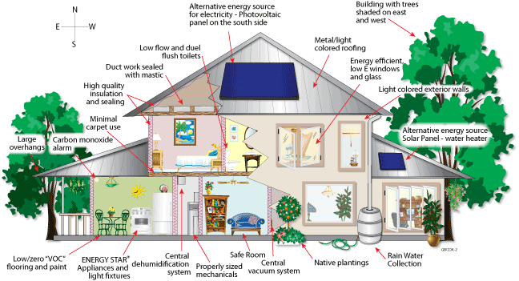
Subjects of Civil Engineering
Building Technology,
Architectural Planning and Design

Slide 11
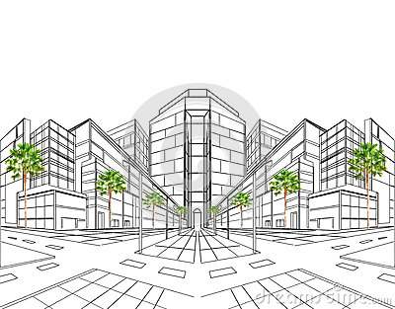
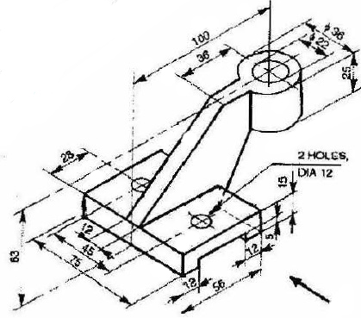
Subjects of Civil Engineering
Engineering Graphics 1&2

Slide 12


Subjects of Civil Engineering
Surveying
Remote Sensing & GIS

Slide 13
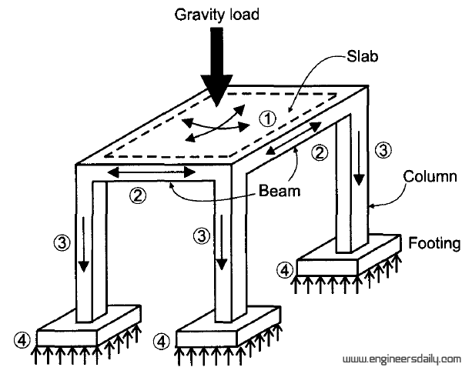
Subjects of Civil Engineering
Concrete Technology
Engineering Mechanics,
Strength of Materials
Foundation Engineering
Structural Analysis & Design
Geotechnical Engineering

Slide 14
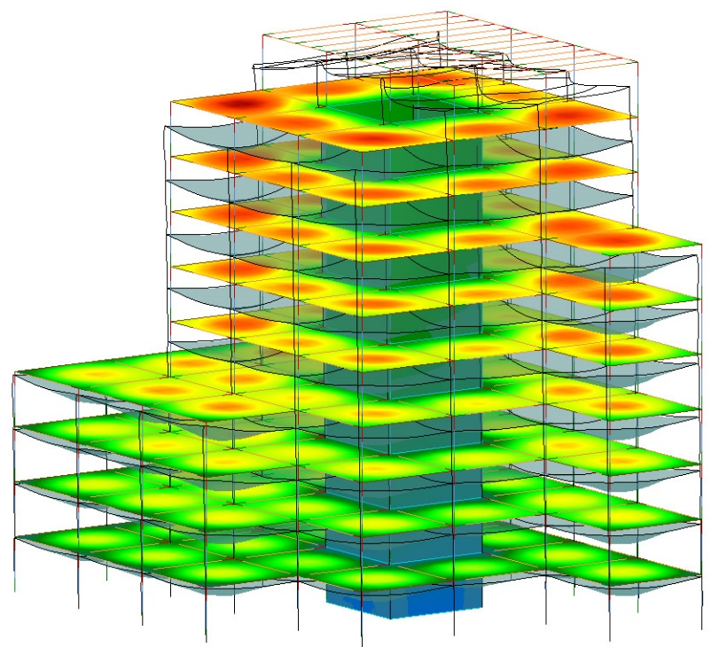
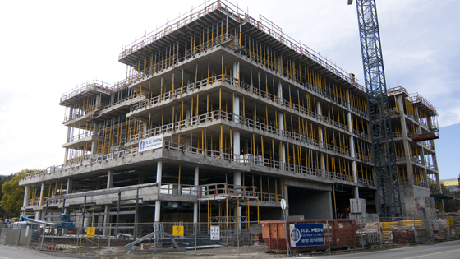
Subjects of Civil Engineering
Math-1,2,3 For Analysis & Design

Slide 15

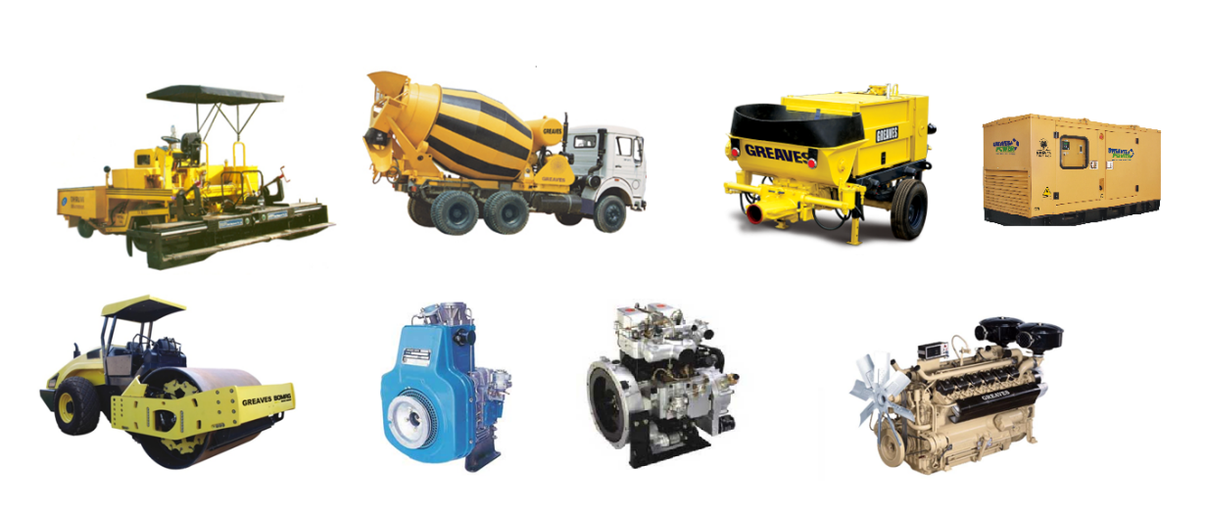
Subjects of Civil Engineering
Basic Electrical, Electronics Engineering
Basic Mechanical Engineering

Slide 16
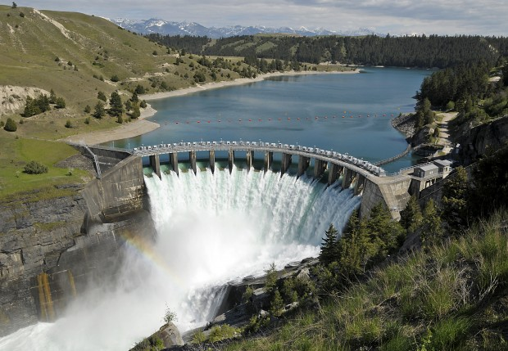
Subjects of Civil Engineering
Environmental Engineering
Fluid Mechanics
RCC /
Pre-stressed /
Steel Structures
Dam & Hydraulic Structures
Hydrology & Water Resources Engg
Engg Geology

Slide 17

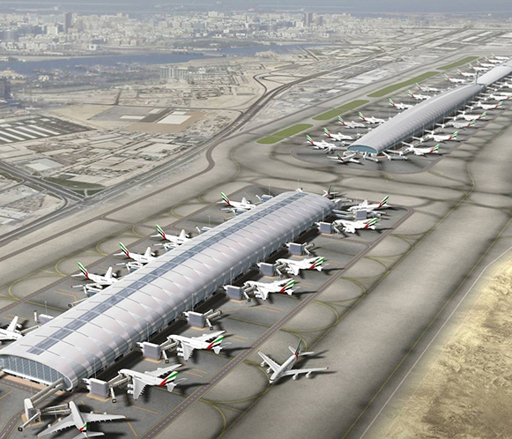
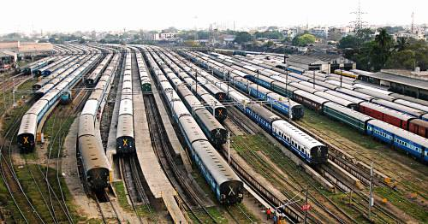
Subjects of Civil Engineering
Infrastructure / Transportation Engineering
Airports
Railway & Metro
Roads and Bridges

Slide 18



Subjects of Civil Engineering
Economic Evaluation
Quantity Surveying,
Project Management

Slide 19
Specializations in CE
Structural Engineering
Transportation Engineering
Geotechnical Engineering
Water Resource /Hydraulics
Irrigation Engineering
Remote Sensing/Geo-informatics/Surveying
Environmental Engineering
Earthquake Engineering
Geology/Geoscience Engineering
Project Management
Construction Management
Maintenance Engineering
And so on…!

Slide 20
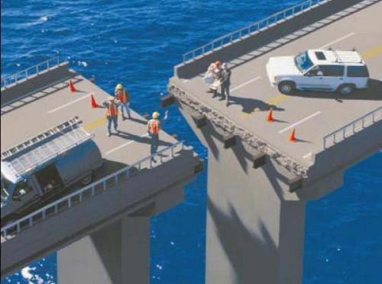
There is no room for errors…

Slide 21

Definitions of degree-
BE/BTech:
I know everything
ME/MTech:
I know something
PhD:
I know NOTHING
and I want to learn
More you study, more you know that how little you know”

Slide 22
Requirements for Career Planning

Slide 23
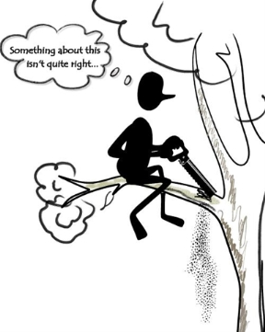

Required - Common Sense

Slide 24

Required - Vision
It is a art of seeing things that are invisible to others.

Slide 25

Required - Discipline

Slide 26

Required - Teamwork

Slide 27

Required - Courage to face challenges

Slide 28


Required - Good Health

Slide 29

Required - Do not reinvest wheel
Reinvention is waste of resources.
Learn from Others
Grow fast

Slide 30

Required - Get it right first time

Slide 31
Required - TIME MANAGEMENT
  Use waiting time
  Identify time wasting culprits and eliminate them.
  have your personal time

Slide 32


Required - COMPUTER/Internet Skills

Slide 33
Planning for Study

Slide 34
Stair method of goal achievement
  Consider a Stair-case.
  You are at bottom.
  Set a small goal at first step.

Slide 35
Stair method of goal achievement
  Work Hard and get it done.
  This will give U lot of confidence.
  Make a habit of celebrating every success.
  Then set next higher goal and get it done.
  Proceed in this way.

Slide 36
Stair method of goal achievement
  Go step by step.
  Never jump directly…! Because if you fails, you will come back to first step.
  Don’t forget Ultimate Aim, which should be achieved with incremental addition.
  Remember: Not failure, but Low Aim Is Crime.

Slide 37
Organization of syllabus.
Go through Complete Syllabus.
Go through previous years question papers.
Identify “Important” & “Urgent” topics.
IMPORTANT:- From exam point of view
URGENT:- From understanding point of view.

Slide 38
Organization of syllabus.
Divide whole syllabus in to four parts as-
Q1
Important & Urgent
Q2
Important but Not Urgent
Q3
Not Important but Urgent
Q4
Neither Important Nor Urgent

Slide 39
Strategy for study
Neither Imp nor Urgent
Imp & Urgent
Not Imp, but Urgent
Imp but not Urgent
Q1:- 50 % time
Q2:- 20% time
Q3:- 20% time
Q4:- 10% time

Slide 40

Strategy for study
It is not necessary and possible also… to command whole syllabus.
Before going to lecture, read / watch a documentary, on topics to be covered in class.

Slide 41
Points to note
E-Learning:
  Y-tube
  NPTEL
  Coursera
  Edx
“Employment News”
Visit UPSC & MPSC Websites-
  www.upsc.gov.in
  www.mpsc.gov.in

Slide 42
Also see…
Visit www.pravinkolhe.com
  Civil Engineering Notes - PDF
  How to Top with Minimum Study – PPT & You-tube Video
  MPSC Engineering Service Examination – PPT
  MPSC Interview Tips – You-tube Video

Slide 43
Career in
Civil Engineering

Slide 44
Career Options for Civil Engineer
1)
Self Employment
2)
Software / IT Related
Academics / R&D
3)
Management
4)
5)
Employment in Core Civil Engineering Sector

Slide 45
Self Employment
Self Employment
Builder
Contractor
Consultancy in-
Project Management
Quality Control
Structural Designer
Contract Management

Slide 46
Software / IT Related
Software / IT
Non-Civil Engg
Civil Engg
E-Governance
Remote Sensing & GIS
Project Management Packages
Structural Design & Drawing Packages

Slide 47
Academics / R&D
Academics / R&D
MTech /PhD / Fellow
Teaching
Scientist: ISRO, BARC, DRDO

Slide 48
Management
Management
Operations
Finance
Human Resource Management
Marketing
Engineering (NICMAR)

Slide 49
Employment in Core CE Sector
Civil Engineering
1. Private Sector
2. Public sector
3. Government Sector
3.1 Non-Engineering
3.2 Engineering

Slide 50
1. PRIVATE SECTOR

Slide 51
Career Options: Core Sector
Private Sector
Real Estate, Building design and construction
Infrastructure- Highways, Airports, SEZ, Oil Companies
Water Resource- Dams and hydraulic structures
Construction planning and management, Quantity Survey
Public sector
SAIL, BHEL, RITE
NTPC, IRCON, EIL
AAI, NHAI, NHPC
Oil sector ONGC, IOCL, HPCL, GAIL

Slide 52
1. Private Sector
Real Estate, Building design and construction
Infrastructure- Highways, Airports, SEZ, Oil Companies
Private Sector
Water Resource- Dams and hydraulic structures
Construction planning and management, Quantity Survey

Slide 53
2. PUBLIC SECTOR

Slide 54
2. Public Sector
SAIL, BHEL, RITE
NTPC, IRCON, EIL
Public sector
AAI, NHAI, NHPC
Oil sector ONGC, IOCL, HPCL, GAIL

Slide 55
3. GOVERNMENT SECTOR
NON-ENGINEERING

Slide 56
3.1 Government Jobs > Non Engg
Civil services
(UPSC)
IAS
IPS
IFS
Other
Civil services
(MPSC)
Dy-Collector
Dy SP
STI
Other

Slide 57
3.2 GOVERNMENT SECTOR
ENGINEERING

Slide 58
3.2 Government Jobs > Engg
Central Govt
(UPSC)
  Indian Engineering Service (IES):-
    CPWD
    Railways
    Central Water Commission
    Military Engineering Service & so on…
State Govt
(MPSC)
  MESE
    PWD
    Water Resource
    Jeevan Pradhikaran

Slide 59
Which Field should I join?
Just ask one question to Ur mind-
  What U want to be after 10 years from now?
  Consider Ur capabilities and limitations…!
  Don’t underestimate or Overestimate Ur self.
  Ur answer will be Ur career
Remember: GOD has created very honorable place for everybody. Your job is just to search it. Unfortunately most people don’t approach in right path.

Slide 60
Line of sight
You
Broad vision
Know world
IPS & PSI
Be inspired from others
Interact with others
Share knowledge
Line of sight
Ur initial aim
C
B
A
You
Datum or base line

Slide 61
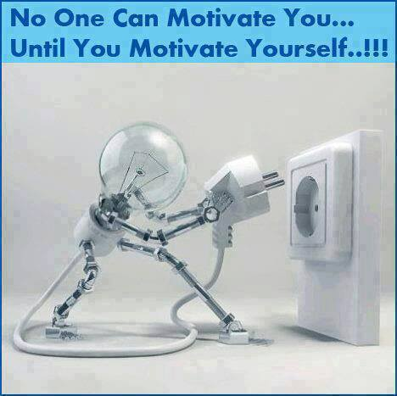
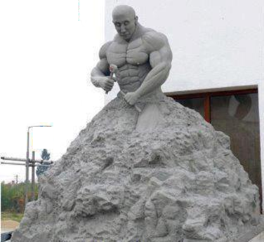
You are creator of your life

Slide 62
Fear of Failure?

Slide 63
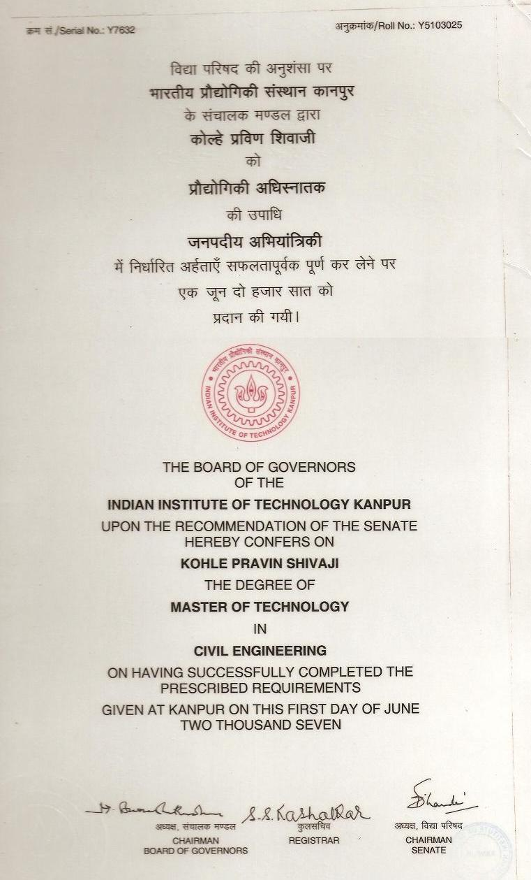
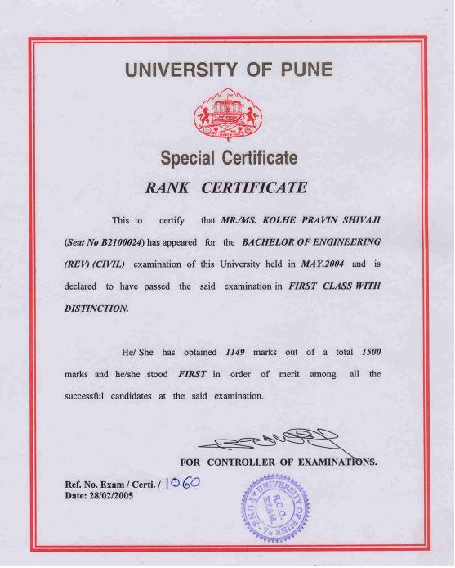
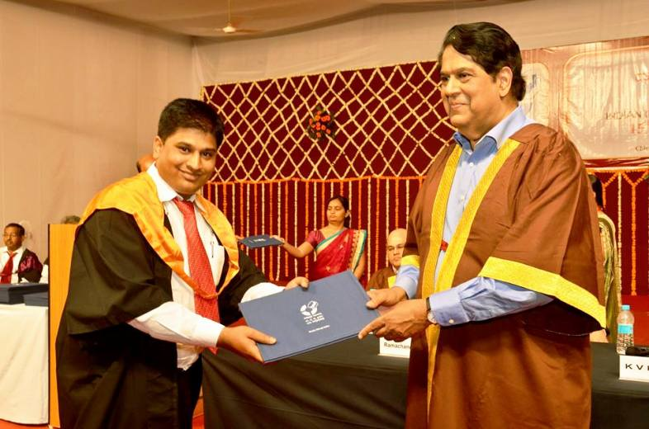
My story
FE (1999-2000) : Ex…! (Year Down)
FE (2000-2001) : All clear
SE (2001-2002) : Class Topper
TE (2002-2003) : College Topper
BE (2003-2004) : University Topper
GATE (2005) : Top 5% in India
MTech @ IIT-K (2005-2007) : Second Topper
MPSC-Engineering Service- Topper in WRD
EPGP @ IIM-I (2013-14): Second Topper

Slide 64
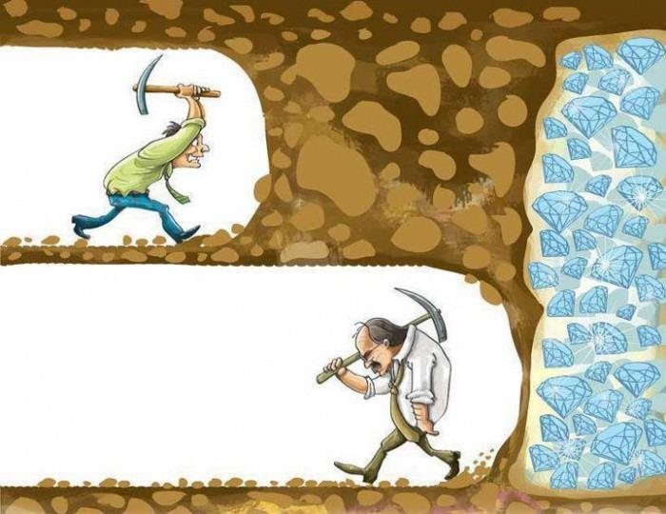
NEVER GIVE UP…

Slide 65



Thank You
This presentations is available at www.pravinkolhe.com

